Slide 1

How to use the World-ready PSD template
Wunderman

Slide 2
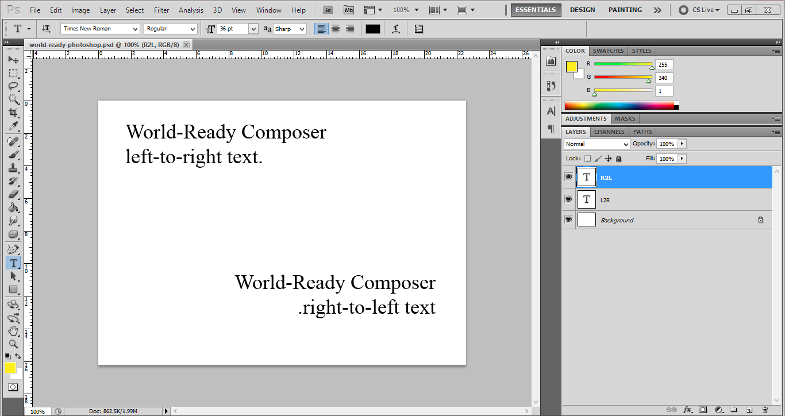
Open the world-ready psd template in Photoshop.

Slide 3
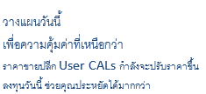
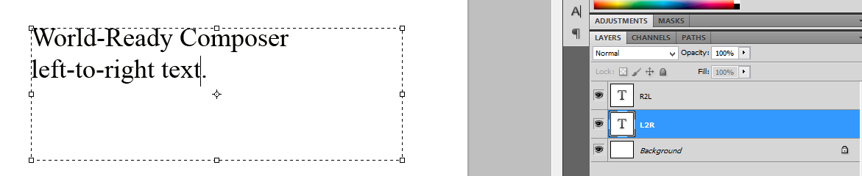
Copy text into the appropriate layer.

Slide 4
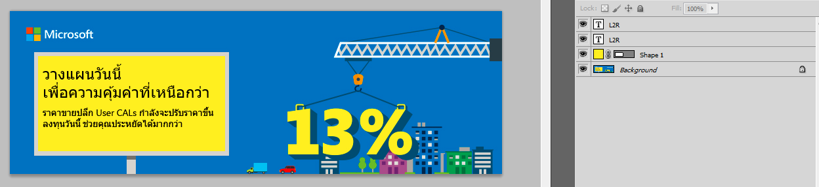
Copy the text layer to the PSD of the image. Adjust and use appropriate font.

Slide 5

Save image. Now it is ready to use for eDMs, webpages, etc.

